Slide 1
Explorer Hat Activity
DC Motor

Slide 2
Call Mr. Brake over at this point to talk about connecting components to your Pi. ** you will need to update the python module for the explorerhat Open the terminal and type pip3 install explorerhat --upgrade

Slide 3
Background Info
An electric motor converts electrical energy into movement using magnetic forces.
There are many variations of the DC (direct current) brush motor.

Slide 4
Background Info
A DC motor typically consists of 2 wires that will attach to your Raspberry Pi.
One wire will go into the Positive (+) Terminal, and the other goes into the Negative (-) Terminal.
Reversing the wires will reverse the direction of rotation.

Slide 5
The Scenario
In the example that follows, you will code a DC motor to:
Rotate forwards
Stop
Rotate backwards
Stop.

Slide 6
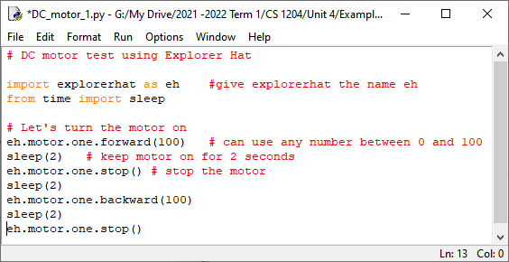
The Code

Slide 7
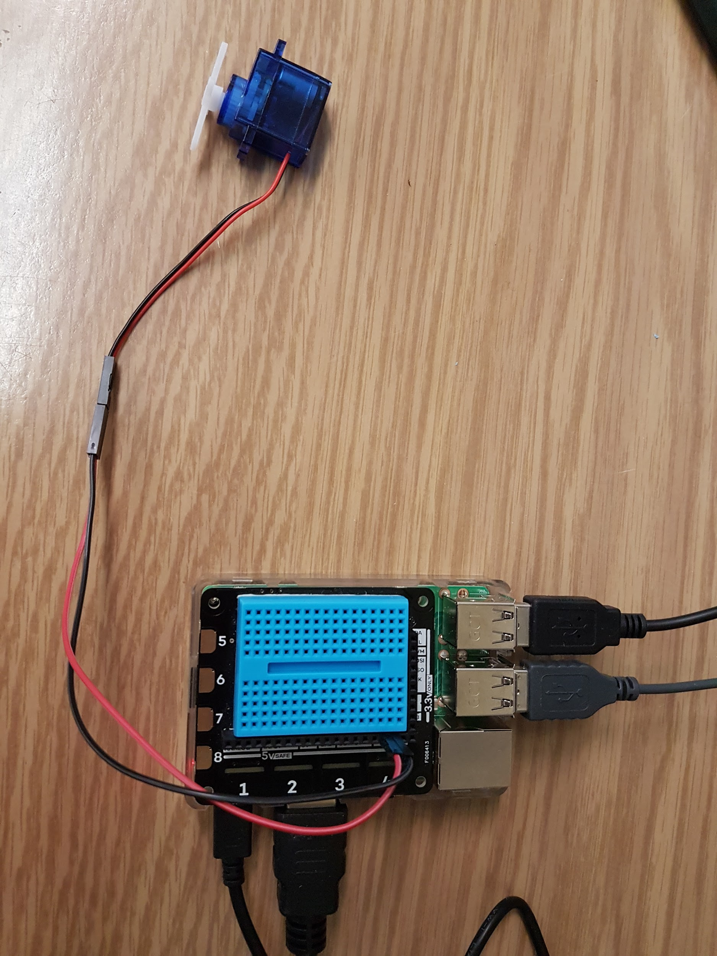
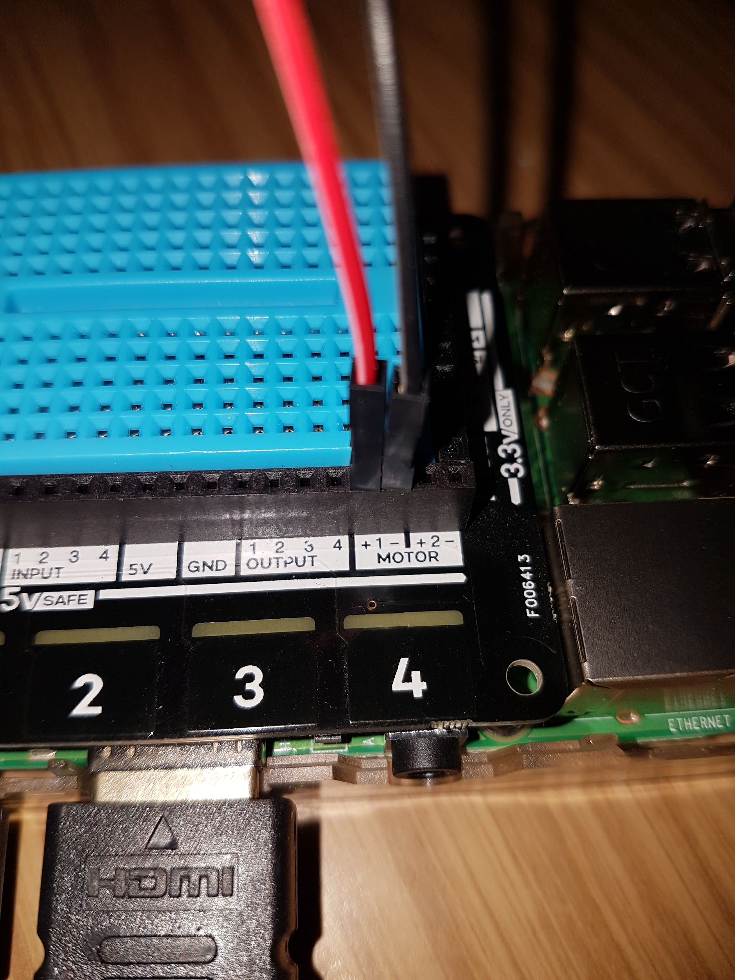
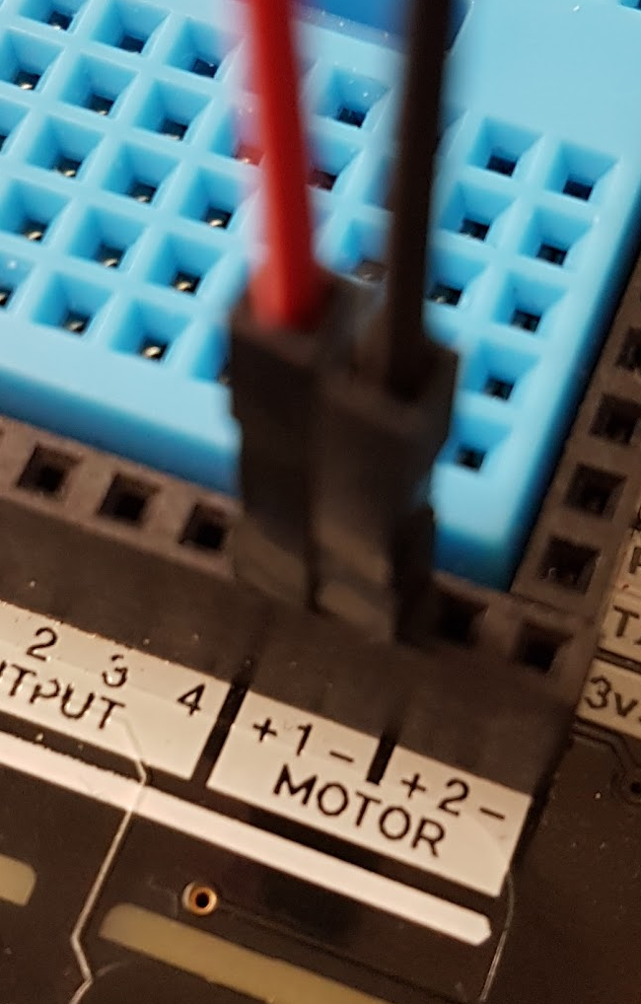
The Setup

Slide 8
In Action
Click the link below to view a video of this circuit in operation.
DC motor Video

